Slide 1

VULCAN — THE 30-SECOND STORY
VULCAN
An AI trading agent that runs an iron condor on the S&P 500.
An iron condor is a bet that the market stays inside a range.
VULCAN forecasts that range with three models — HAR, GARCH and machine learning — prices the structure, enters it through the Alpaca API, and guards it 24/7.
IT MADE A PROFIT ON DAY ONE.
AI Trading Agents Hackathon · lablabai x AlpacaHQ · Options Alpha Agents Track
VULCAN · 01

Slide 2
01 — THE IRON CONDOR
A bet that the market stays inside a range
You sell two credit spreads at the same time:
PAYOFF AT EXPIRY
PUT CREDIT SPREAD · BELOW
CALL CREDIT SPREAD · ABOVE
SELL 500 PUT
BUY 495 PUT
SELL 510 CALL
BUY 515 CALL
+$150 MAX PROFIT
If SPY closes between 500 and 510 at expiry, both spreads expire worthless — you keep the credit.
Max profit = credit collected
Max loss = strike width − credit = $5.00 − $1.50 = $3.50/share → $350
Breakevens = put short − credit (498.50) · call short + credit (511.50)
$0
498.5
511.5
−$350 MAX LOSS
495
500
510
515
AI Trading Agents Hackathon · lablabai x AlpacaHQ · Options Alpha Agents Track
VULCAN · 02

Slide 3
02 — THE THREE FORECAST MODELS
Three models vote on where the range will be
HAR
GARCH(1,1)
MACHINE LEARNING
THE RANGE FORECAST
THE VOLATILITY UPDATE
THE NON-LINEAR EDGE
σ²(week) = c + βd·σ²(day)
+ βw·σ²(week) + βm·σ²(month)
σ²(t) = ω + α·ε²(t−1)
+ β·σ²(t−1)
features = [ daily range, volume,
IV skew, IV term structure, VIX ]
βd ≈ 0.4 βw ≈ 0.3 βm ≈ 0.3
Blends daily, weekly and monthly ranges into one weekly forecast.
The forecast range tells VULCAN where to place the strikes.
α ≈ 0.1 (surprise) β ≈ 0.85 (persistence)
Volatility is mean-reverting: α + β ≈ 0.95 < 1, so shocks decay and σ returns to its long-run level.
Yesterday's surprise still matters today.
Captures what linear models miss:
puts cost more than calls (IV skew) and the term structure slope tells the regime.
The ML model flags when the condor is mispriced.
OUTPUT: forecast weekly range → strike placement
OUTPUT: updated weekly σ → credit target
OUTPUT: skew flag → is the condor worth selling?
AI Trading Agents Hackathon · lablabai x AlpacaHQ · Options Alpha Agents Track
VULCAN · 03

Slide 4
03 — THE 12 COMPONENTS
Every part has one job
01
02
03
04
Data Ingestion
Forecast Engine
Signal Engine
Entry Engine
pulls live prices from Alpaca
runs the three models
decides when to enter
sizes the structure
05
06
07
08
Entry Sizer
Iron Condor Entry
Execution Engine
Guard
sets the strike widths
builds the four-leg structure
sends orders to Alpaca
monitors 24/7
09
10
11
12
Risk Engine
Kill Switch
Backtest Engine
Backtest Infra
caps the exposure
closes everything
tests on history
the framework
AI Trading Agents Hackathon · lablabai x AlpacaHQ · Options Alpha Agents Track
VULCAN · 04

Slide 5
04 — THE SIX FIXES
Real engineering: what broke, and the fix
FIX 1 · THE ENTRY WAS BLOCKED
FIX 2 · STRIKE WIDTHS WERE WRONG
FIX 3 · EXECUTION WAS REJECTED
The entry was blocked
Strike widths were wrong
Execution was rejected
✗ the four-leg structure was rejected
✗ strikes were placed too close
✗ Alpaca refused the combined order
✓ rebuilt the entry to build the four legs one at a time
✓ used the forecast range to set the strike widths
✓ sent each leg separately
FIX 4 · THE GUARD WAS MISSING
FIX 5 · THE RISK WAS UNCAPPED
FIX 6 · NO KILL SWITCH
The guard was missing
The risk was uncapped
No kill switch
✗ nobody was watching the position
✗ exposure was unbounded
✗ no way to close everything
✓ built the guard to monitor 24/7
✓ capped the exposure with the risk engine
✓ added the kill switch
AI Trading Agents Hackathon · lablabai x AlpacaHQ · Options Alpha Agents Track
VULCAN · 05

Slide 6
05 — THE PROFIT MATH
One trade, four numbers
CREDIT COLLECTED
MAX LOSS (BOUNDED)
BREAKEVENS
$150
$350
498.5 / 511.5
$1.50 per share × 100 shares
= $150.00 cash up front
strike width − credit = $5.00 − $1.50
= $3.50 per share × 100 shares
put short − credit = 500 − 1.5 = 498.5
call short + credit = 510 + 1.5 = 511.5
+$150 if the range holds
known before entry — by design
the range with a $1.50 buffer
DAY-ONE RESULT
PROFIT — the range held, the credit was kept. The loop works end to end.
AI Trading Agents Hackathon · lablabai x AlpacaHQ · Options Alpha Agents Track
VULCAN · 06

Slide 7
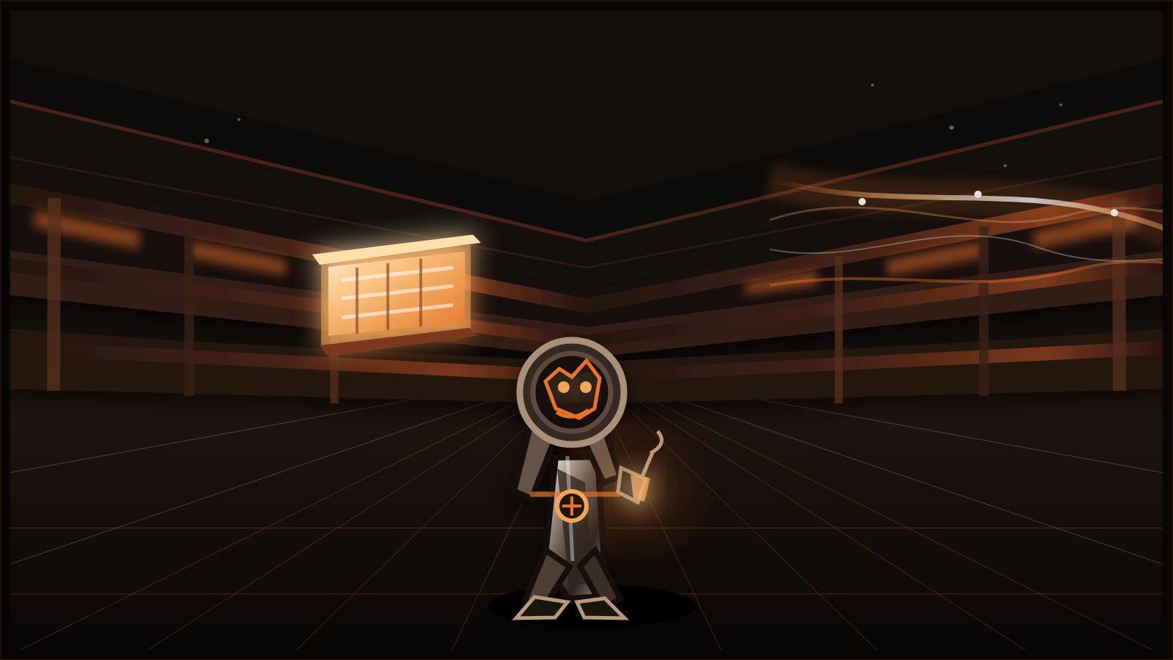
06 — THE BACKTEST
Nothing goes live until history agrees
The backtest engine replays history through the full loop — forecast, signal, entry, guard, exit — exactly as it runs live.
Same code path in test and in production. What passed the backtest is what trades.
The backtest infrastructure is the framework every strategy change must survive.
THE GATE: no strategy change ships without a backtest pass.
AI Trading Agents Hackathon · lablabai x AlpacaHQ · Options Alpha Agents Track
VULCAN · 07

Slide 8
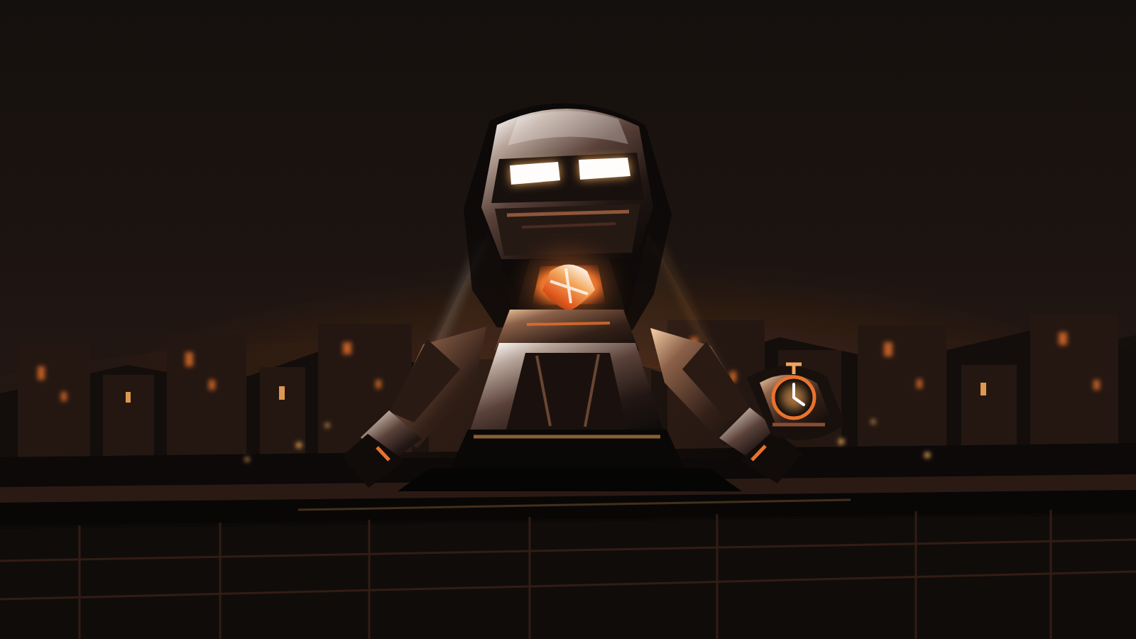
07 — THE GUARD
Somebody is always watching
The guard monitors the position 24/7 — every fill, every greek, every minute to expiry.
It acts without a human awake: rolling inside 2 days to expiry, exiting at thresholds, flagging anomalies to the desk.
Fix 4 existed because nobody was watching. Now something always is.
AUTO-ROLL RULE: inside 2 days to expiry → roll or exit. No human needed.
AI Trading Agents Hackathon · lablabai x AlpacaHQ · Options Alpha Agents Track
VULCAN · 08

Slide 9
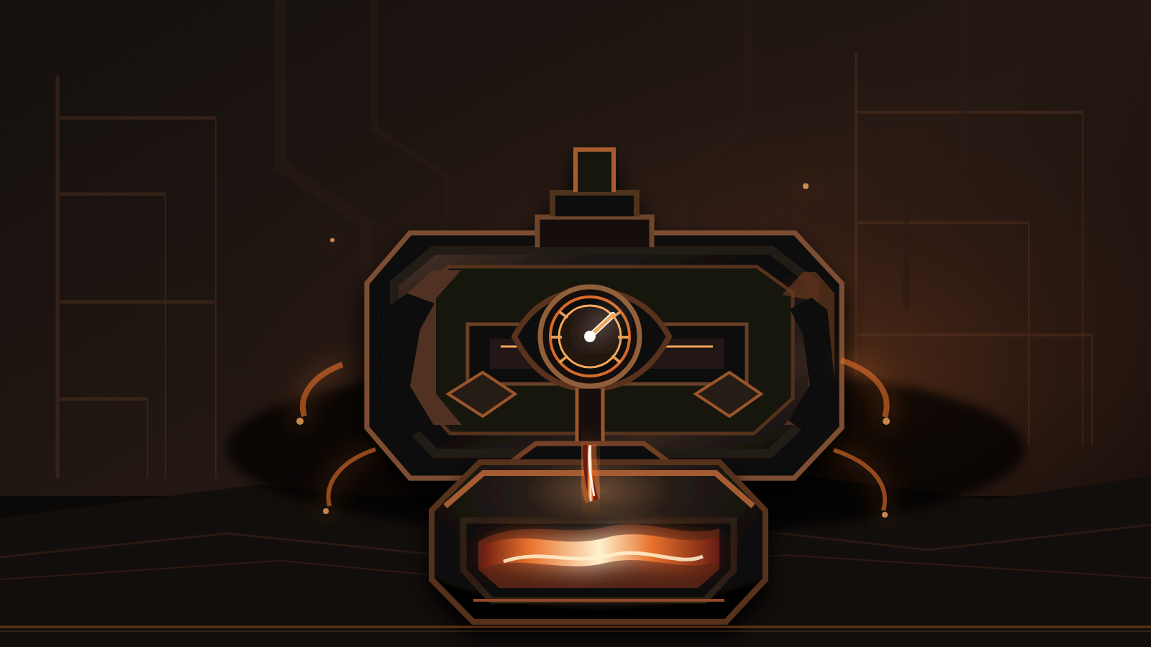
08 — THE RISK ENGINE
Exposure has a hard ceiling
Every structure is defined-risk by construction: the worst case is known before entry.
The risk engine caps total exposure, blocks any trade that would breach the cap, and enforces the discipline gates with zero exceptions.
Max loss per condor: $350. That number is a design decision, not a hope.
AI Trading Agents Hackathon · lablabai x AlpacaHQ · Options Alpha Agents Track
VULCAN · 09

Slide 10
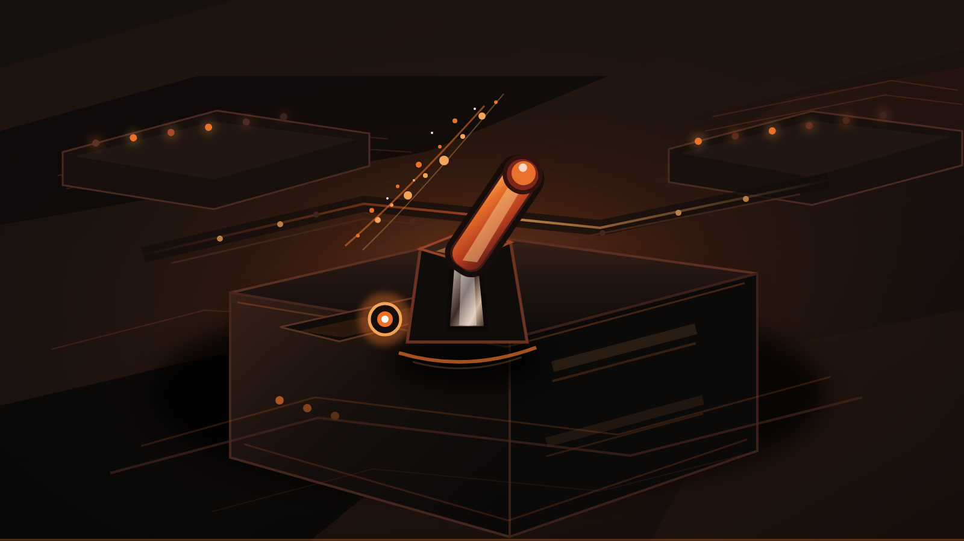
09 — THE KILL SWITCH
One command closes everything
The kill switch flattens every position in one stroke — no negotiation, no partial states.
It sits outside the AI stack and works even when every model and API misbehaves. Fail-safe by default.
Fix 6: it did not exist. Now it is the last line of defence.
AI Trading Agents Hackathon · lablabai x AlpacaHQ · Options Alpha Agents Track
VULCAN · 10

Slide 11
10 — THE NUMBERS
The whole trade on one slide
+$150
$350
498.5 / 511.5
DAY ONE
CREDIT COLLECTED
MAX LOSS
BREAKEVENS
RESULT
if the range holds
bounded before entry
the range with buffer
profit
Defined risk, kept simple: the worst case is $350 by construction, the reward is the credit, and the forecast decides where the range — and therefore the strikes — goes.
AI Trading Agents Hackathon · lablabai x AlpacaHQ · Options Alpha Agents Track
VULCAN · 11

Slide 12
11 — WHAT'S NEXT
More underlyings. More structures. Longer horizons.
MORE UNDERLYINGS
MORE STRUCTURES
LONGER HORIZONS
The framework is built.
The framework runs.
The framework scales.
Educational hackathon project · Paper trading only · Nothing here is financial advice

